Slide 1
DermAI Diagnostics Skin Cancer Analytics
SQL Capstone Project
By Pod Orion, 03 October 2026

Slide 2
Information about the Company
DermAI Diagnostics Skin Cancer
DermAI Diagnostic company’s
Business model focuses on bridging the gap between medical practitioners and machine learning-based skin lesion classification by:
  Providing a structured dataset and digital tools that support medical research, epidemiological studies, and AI-driven skin cancer detection; and
  Creating data-driven insights that can assist dermatologists in early-stage detection of skin cancer, enhance both the quality and the timeline of decision-making, and ultimately improve public health outcomes
      Through a combination of AI-powered diagnostic tools, real-world clinical data, and SQL-based research

Slide 3
Business Problem & Required Interventions
DermAI Diagnostics Skin Cancer
Business Problem
Delay in skin cancer detention due to:
  Misdiagnosis
  Lack of access to dermatologists, and
  Limited understanding of environmental risk factors
Required Interventions
Leveraging the company’s skin lesions and related dataset
  Uncover key patterns that link demographics, environmental exposure, and lesion characteristics to different types of skin cancer
  Develop evidence-based insights that can enhance early-stage diagnosis and machine learning-based decision support
  By structuring the data for SQL queries, analysis, and model training

Slide 4
Key Analytics for the Project
DermAI Diagnostics Skin Cancer
Key analytics direction for the skin cancer project
Develop a SQL database for students to practice joining clinical and lesion data for effective skin
Identify environmental and demographic risk factors that correlate with specific skin lesions
Analyse lesion characteristics to find patterns that indicate cancerous vs. benign lesions
Create a machine learning-ready dataset that supports AI-based early detection of skin cancer using structured metadata
Enhance dermatological research by providing a well-organized dataset for epidemiological studies and AI model training

Slide 5
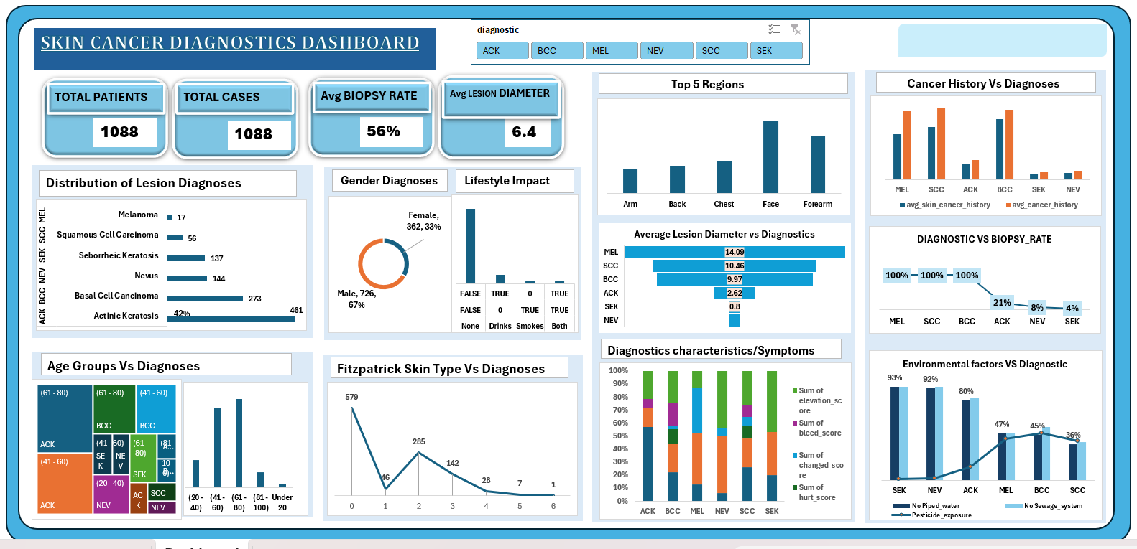
DermAI Diagnostics Skin Cancer

Slide 6
Key Insights…
DermAI Diagnostics Skin Cancer
Three of the six lesion diagnoses observed from the data were benign and precancerous lesions:
  Nevus (Mole), Seborrheic Keratosis, and Actinic Keratosis
  Together, these accounted for 68% of all diagnoses
The remaining half were types of skin cancer:
  Basal Cell Carcinoma, Squamous Cell Carcinoma, and Melanoma
  The combined proportion of all diagnoses was 32%

Slide 7
…Key Insights
DermAI Diagnostics Skin Cancer
A much higher proportion of all cases were diagnosed for males than females:
  Males (726 cases: signifying 67% of all cases); and
  Females (362 cases: which represents 33% of all cases)

Slide 8
…Key Insights
DermAI Diagnostics Skin Cancer
Facial lesion diagnosis was about a quarter (25.6%) of lesions diagnoses across all body regions
Face, Forearm, Chest, and Back were the top-4 body regions’ lesion diagnoses, accounting for:
  Over two-thirds (66.7%) of all the 14 body regions diagnosed for lesions
  Diagnoses were above 100 cases for each of the four body parts
The four body regions with the lowest diagnoses were Abdomen, Scalp, Lip, and Foot: whose combined diagnoses were:
  Less than 50 cases (just 4%) of all lesion cases diagnosed

Slide 9
…Key Insights
DermAI Diagnostics Skin Cancer
Fitzpatrick Scale measures the amount of melanin pigment in one’s skin:
  Skin Type 0 has the highest record of diagnoses of 579
  Skin Type 6 has the least record of 1 person.

Slide 10
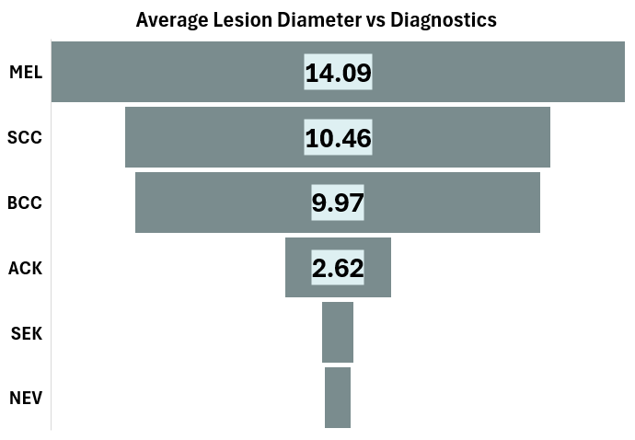
…Key Insights
DermAI Diagnostics Skin Cancer
Majority of the lesion size(diameter) is 0 :
  Melanoma has the highest Average diameter of 14.09mm

Slide 11
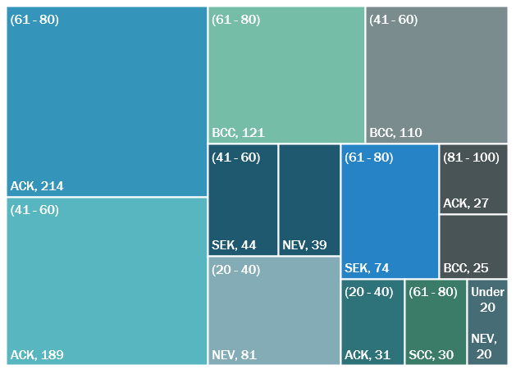
…Key Insights
DermAI Diagnostics Skin Cancer
Lesion diagnoses across age groups
Over three-quarters (78.4%) of all lesion cases diagnosed were people within two age brackets:
  41-60 years (405 cases: representing 37.2% of all cases); and
  61-80 years (448 cases: representing 41.2% of all cases)
Lowest cases records were among the youngest and the oldest:
  81-100 years (78 cases: representing 7.2% of all cases); and
  Under 20 years (20 cases: representing 1.8% of all cases)

Slide 12
…Key Insights
DermAI Diagnostics Skin Cancer
Average cancer history was higher than average skin cancer history:
  Among the Benign and precancerous lesions’ diagnoses
  Nevus (Mole), Seborrheic Keratosis, and Actinic Keratosis;
  And
  Among the three types of skin cancer identified in the data
  Basal Cell Carcinoma, Squamous Cell Carcinoma, and Melanoma

Slide 13
…Key Insights
DermAI Diagnostics Skin Cancer
Smoking/ Drinking Lifestyle:
  Significant amount of patients were NONE alcoholics and Smokers.
  There are very little corelation/impact of drinking or smoking and diagnoses .

Slide 14
…Key Insights
DermAI Diagnostics Skin Cancer
Some environmental exposures negatively contributed to skin conditions:
  Lack of access to piped water and absence of sewage system significantly contributed to benign and precancerous lesions’ diagnoses such as;
  Seborrheic Keratosis, Nevus (Mole), and Actinic Keratosis
  Pesticide exposure, and both the lack of access to piped water and the absence of sewage system also had major negative effects on the three types of skin cancer identified in the data
  Basal Cell Carcinoma, Squamous Cell Carcinoma, and Melanoma

Slide 15
…Key Insights
DermAI Diagnostics Skin Cancer
This chart shows the diagnostic lesions that were biopsy-confirmed:
  The 3 types of skin cancers identified in the data were all 100% biopsy-confirmed. These cancers are;
  Basal Cell Carcinoma, Squamous Cell Carcinoma, and Melanoma
  Overall confirmed biopsy rate is 56%

Slide 16
…Key Insights
DermAI Diagnostics Skin Cancer
Diagnostic Characteristics/Symptoms:
  Actinic Keratosis has an average score of 80% itchiness.
  Basal Cell Carcinoma has (90% Elevation, 80% growth and itchiness respectively and 60% Bleeding rate.
  Melanoma
  Nevus (Mole)
  Squamous Cell Carcinoma
  Seborrheic Keratosis

Slide 17
Recommendations
DermAI Diagnostics Skin Cancer
Overhaul the data collection and documentation procedures to reduce the proportion of unknown records (Especially with respect to family background, which was more than 50% of the data used for this analysis)
Expand access to piped water and sewage system
Embark on campaigns to communicate the negative impact of harmful substances(Pesticide) on health across all age groups and genders
Understand the reasons for the prevalence of benign, pre-cancerous and cancerous skin conditions in males and those within the 41-60 and the 61-80 age groups
Investigate why each and the combined risk levels of the Face, the Forearm, the Chest, and the Back were the highest among the 14 body regions’ lesions that were diagnosed , and how these risks exposures can be reduced
Early identification of ACK (pre cancerous) which has the highest diagnosis (42%) as it develops to SCC if not managed
Previous skin-cancer history and family cancer history are also associated with higher BCC/SCC shares, which needs further investigation.
Identify Melanoma early and start early interventions because it has the highest change rate (80%) and growth rate (90%); And BCC has the highest bleeding rate a 60%

Slide 18
DermAI Diagnostics Skin Cancer
THANK YOU

